Slide 1


Titolo presentazione sottotitolo
DESIGN BY NATURE
ASTROHORNET: AUTONOMOUS FREE-FLYER ASSISTED BY INTELLIGENT DAMAGE LOCALIZATION SYSTEM
HELLO DEBRIS:
Alberto Chiaradia
Ali Raza Asghar
Andrea Laus
Vahid Nateghi
Vincenzo Forgione
Milano, XX mese 20XX

Slide 2
Problem: amount of space debris in 21° century
Nowdays number of launches of objects to space is increasing continously. It follows that the number of space debris is increasing as well.
It means that there is more possibility, for a satellite, to be hit by a space debris while there are no actual tecnologies that would help astronauts to detect impacts in an autonomous way.
2

Slide 3
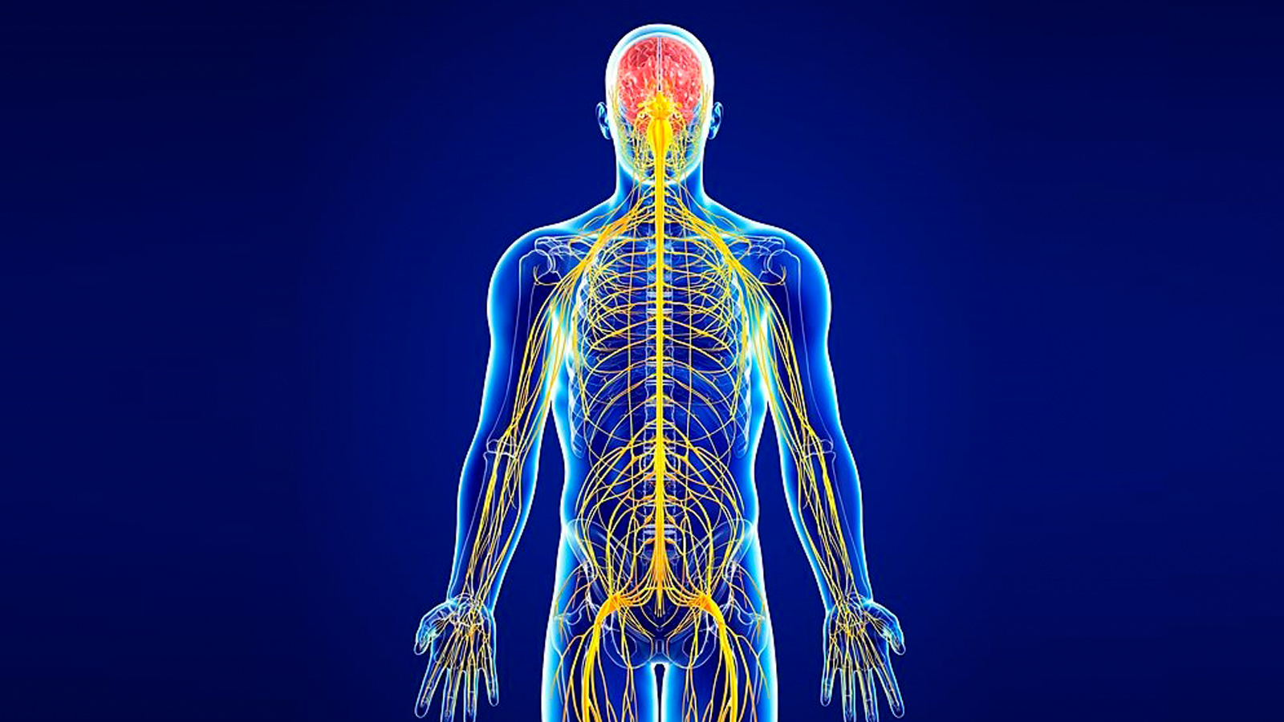
Design by nature
The brain is the center of all the signals sent and received by our body. When something hurts us, our brain sends us the level of pain and its location.
3

Slide 4

Design by nature
We took inspiration from our nervous system to create an interactive net on the satellite, in order to communicate its ‘pain’.
4

Slide 5
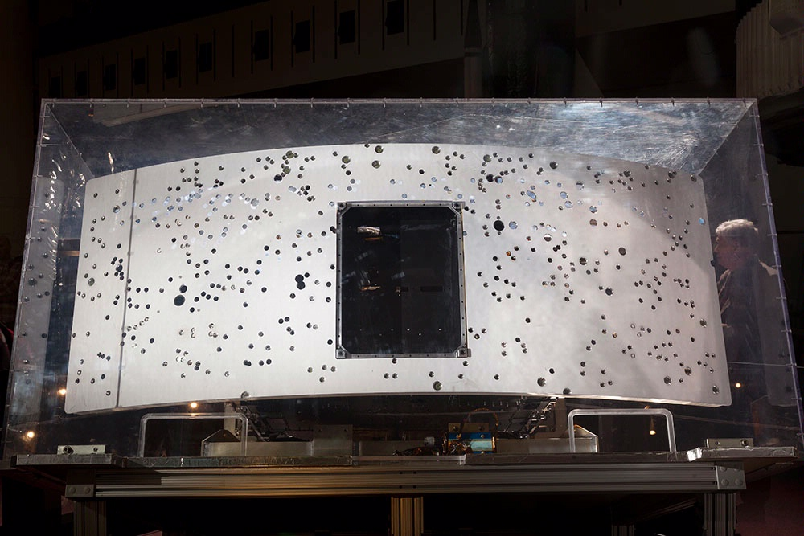
Solution: Astrohornet
Our purpose is to design an autonomous Free-Flyer in order to give astronauts informations about any impact of MMOD with the satellite.
5

Slide 6
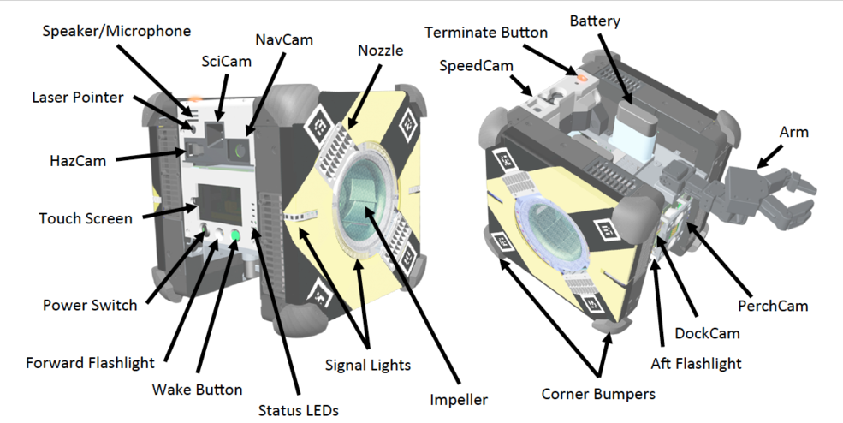
Astrobee (NASA) structure
6

Slide 7
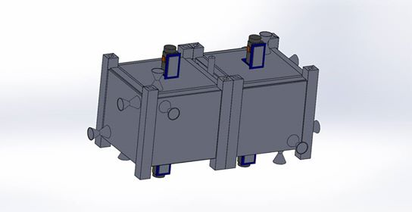
Astrohornet structure
Antenna
HazCam
LED
Laser grid projector
Missions data storage HD
Nozzles
Attitude control modules: 3 axis cold gas propulsion
GDS HD
Gyroscope
Reservoir
CPU (Inforce 6509 micro SOM)
3 axes accelerometers
Docking system + ethernet and charging system
Batteries
NavCam
7

Slide 8
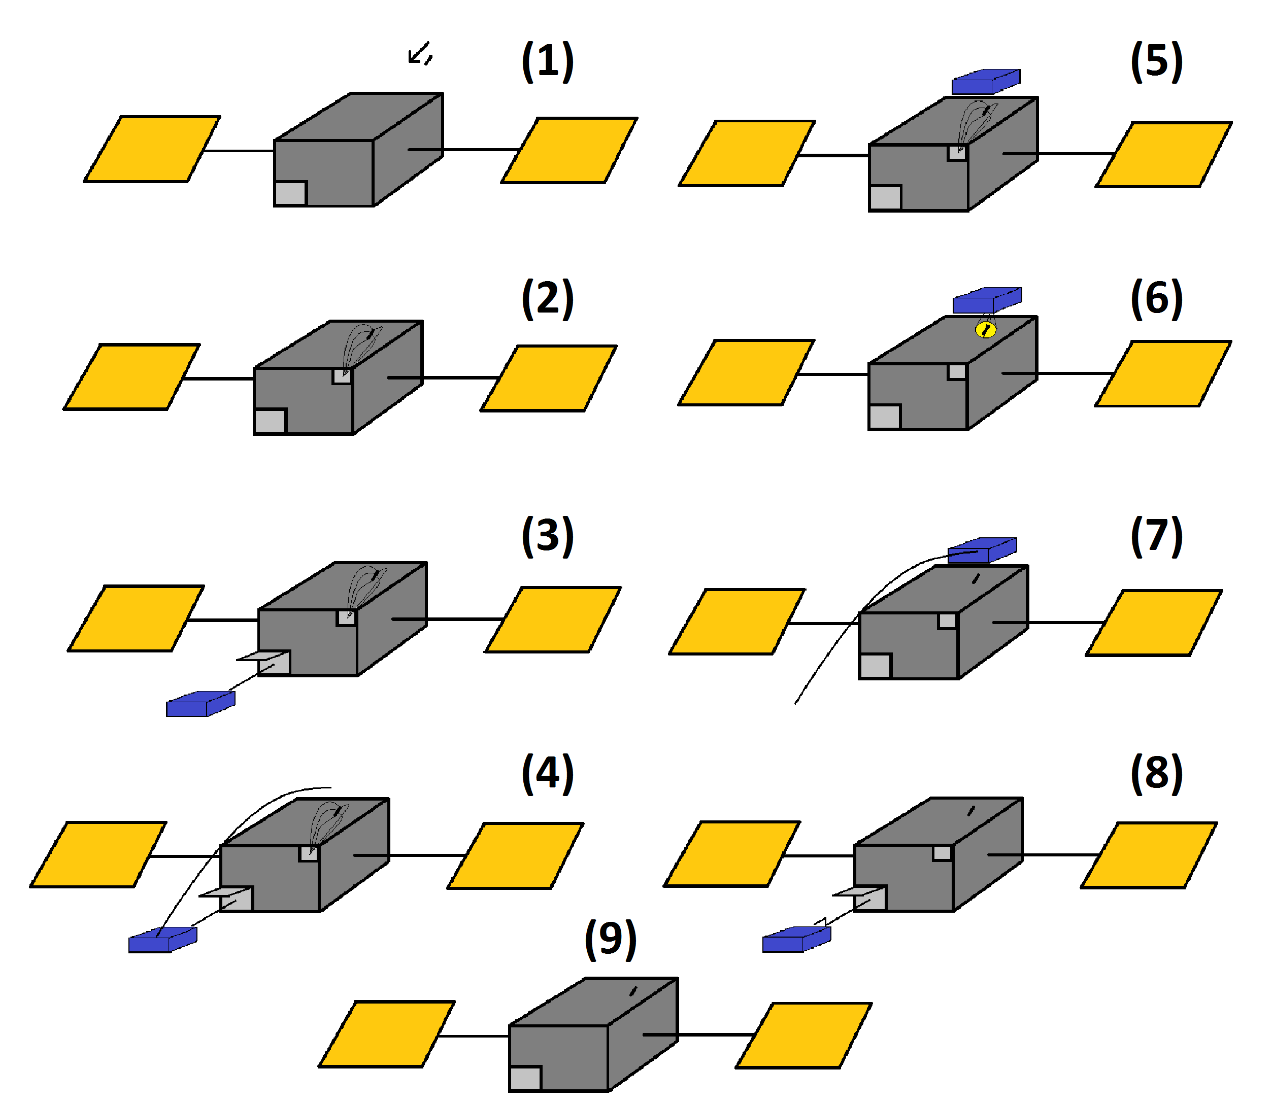
Concept of Operation
8

Slide 9
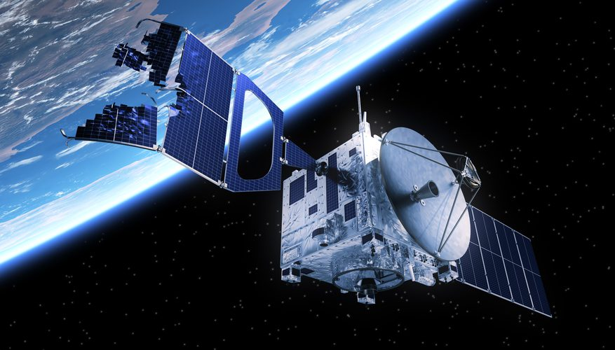
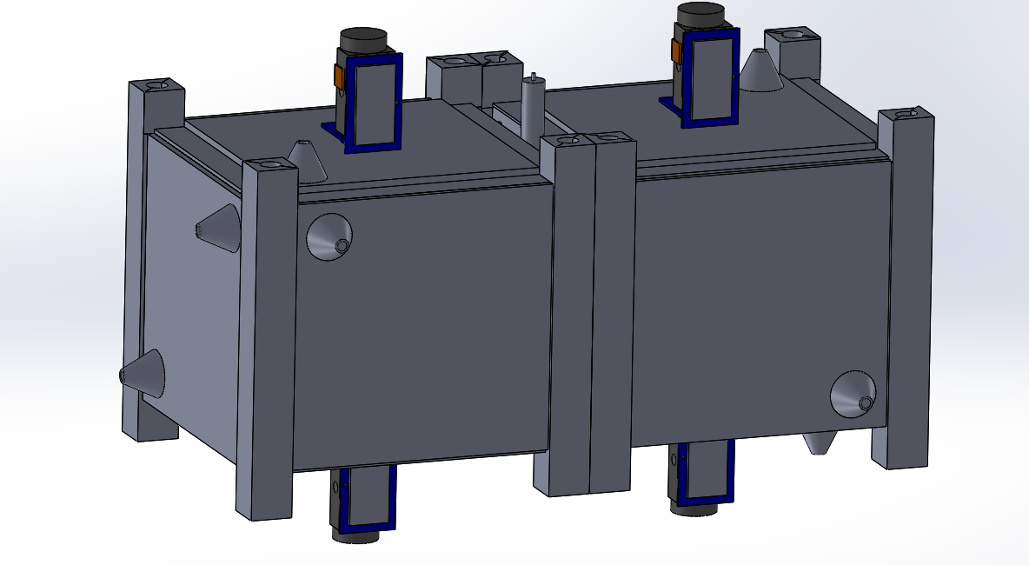
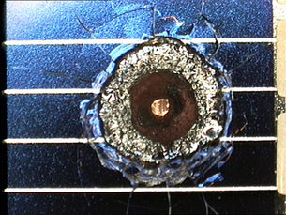
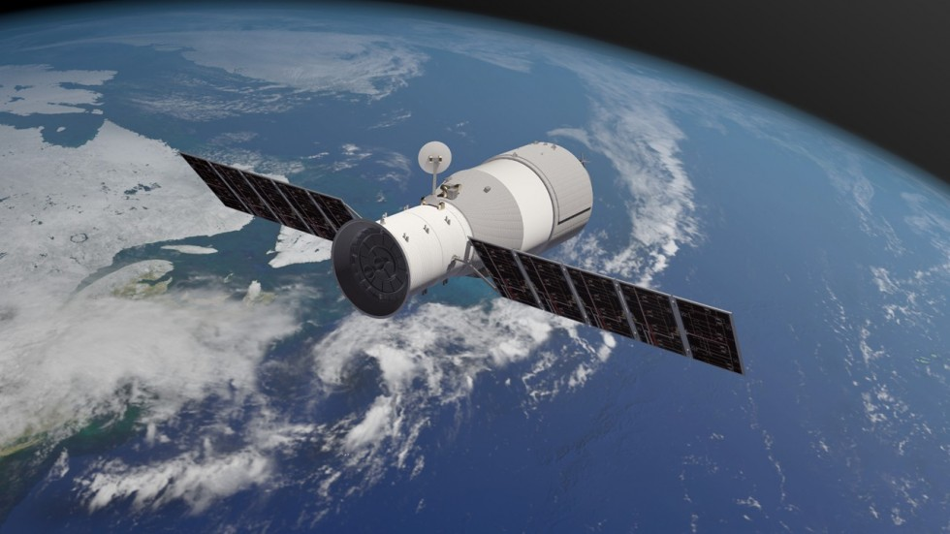
Mission Plan
Impact detection
Free-Flyer take-off
Path planning
Elaboration of images
Come back
9

Slide 10
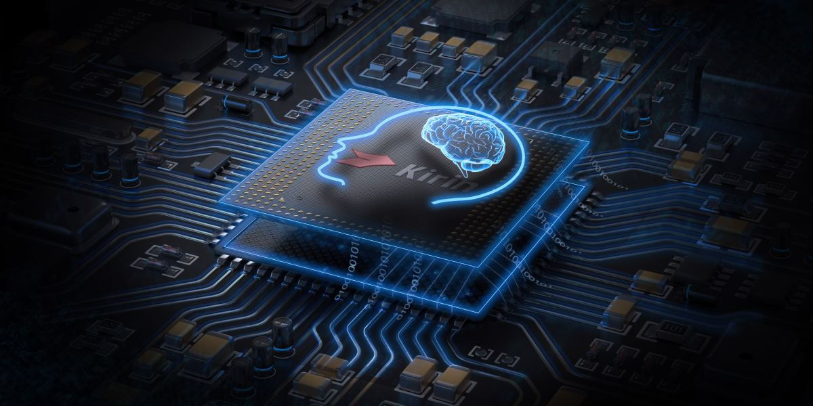
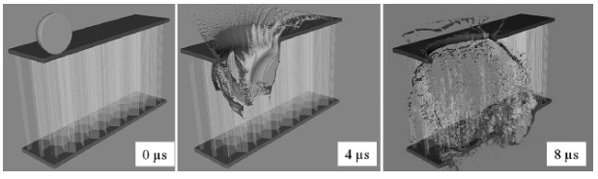
Impact Detection
Main Body
Sensor Net Integrated into Structures
Panels
Machine Learning
10

Slide 11
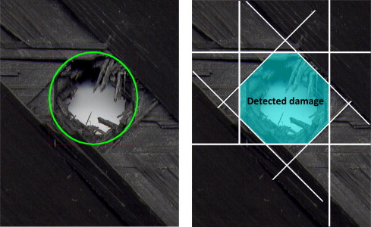
Impact Detection
Net of Structures
We want to build a grid of circuit sensor around the satellite, integrating it with shielding structure in actual development. It consists in sensors systems that will use different parallel layers of conductive material alternated with layers of a polymeric flexible materials.
[Credits, A.Francesconi, Università di Padova]
11

Slide 12
TECHNOLOGY: graphene in conductive multi-layered circuits
“…we find that the in-plane electronic thermal conductivity κ_{e} of doped graphene is ∼300 W/mK at room temperature, independently of doping. This result is much larger than expected and comparable to the total thermal conductivity of typical metals, contributing ∼10% to the total thermal conductivity of bulk graphene. “
[“ The Electronic Thermal Conductivity of Graphene”, Tae Yun Kim, Cheol-Hwan Park, and Nicola Marzari ” Seoul National University]
12

Slide 13
TECHNOLOGY: additive manufacturing process
“Moreover, since the components are built layer by layer, it is possible to design internal features and
passages that could not be cast or otherwise machined.
…These could have applications in highdemanding components, for instance in automotive and aerospace
industries, where it is necessary to improve stiffness, hardness and high temperature properties.”
[As it said in https://www.intechopen.com/books/light-metal-alloys-applications/additive-manufacturing-of-al-alloys-and-aluminium-matrix-composites-amcs-]
13

Slide 14
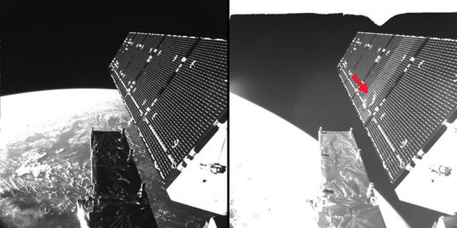
Impact Detection
Machine Learning
By collecting many images of impacts on the solar panels, we can teach our software, through the help of cameras, to recognize whether it’s broken or no.
14

Slide 15
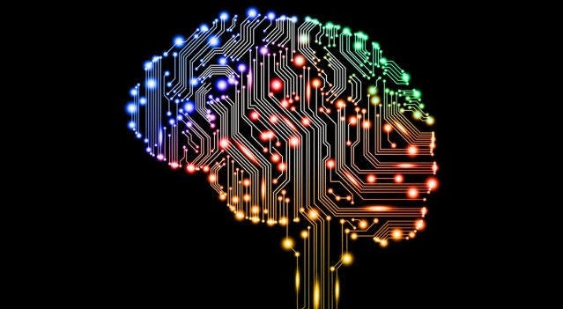
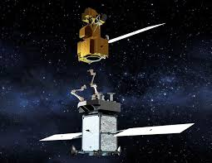
Free-Flyer take-off
The brain knows that there’s a damage at a certain position and the Free-Flyer has to find out the level of the damage.
The main structure has to undock the Free-Flyer. An arm bring it outside and it’s ready to move.
15

Slide 16
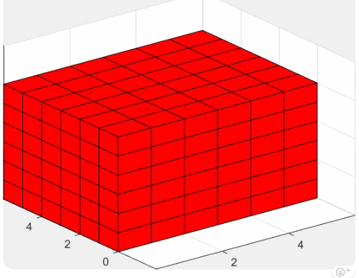
Path Planning: Potential Field Method
The satellite’s brain is able to compute the path through which we can arrive at the final position with a preset security offset.
16

Slide 17
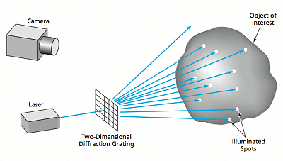
Path Planning
Once we have reached the hit point, we take pictures from the 2 Free-Flyer’s cameras. It also features a laser grid: the deflection of straight lines, which identifies the hole position, is used to keep the Free-Flyer still with respect to the hole.
17

Slide 18
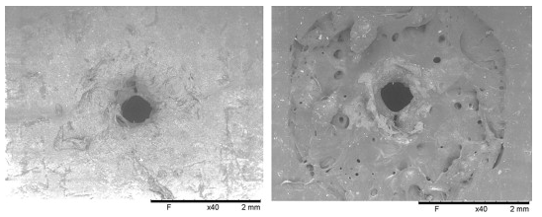
Elaboration of Images
Through elaboration of the images on the Free-Flyer, due to the huge amount of pictures about impacts we taught it, it can create a 3D model of the damage and send this image to crew.
18

Slide 19
Come Back and Docking
UNDOCKING & MOTION
Minimum Potential Method
DAMAGE MAPPING: Hot Spots Recognition
N
Position is inside the Motion Domain?
(Antenna Communication)
Y
NavCam + laser grid for damage detection
SNR > K
Y
Recall to Docking Base
N
HazCam pics acquisition
On-board storage of data
Level of Impact &
Level of damage
classification
DAMAGE REPORT & DATA DOWNLOAD
On-board storage of data
DOCKING & LOCK
19

Slide 20
Conclusion and Future Development
Through the use of new technologies in a non common way, we tried to give a solution to the important problem of space debris damages detection, taking inspiration from the the nervous system.
For the future work, the tests and validation methods that uploaded before, should be accurately done in order to make it also cost effective to commercialize it.
More information can be found at:
https://2018.spaceappschallenge.org/challenges/can-you-build/design-based-nature-fusion/teams/hello-debris/project
20

Slide 21
References
[1] M. Williams, M. Lewis, T. Gibson, J. Lane , P. Medelius, “Detection Sensor System for Aerospace and Multiple Applications”, NASA
[2] A. Francesconi, “Effects of high-speed impacts on CFPR plates for space applications”
[3] A. Francesconi, “Comparison of self-healing ionomer to aluminium-alloy bumpers for protecting spacecraft equipment from space debris impacts
[4] Trey Smith, Jonathan Barlow, Maria Bualat, Terrence Fong, Christopher Provencher, Hugo Sanchez, Ernest Smith, “Astrobee: A new platform for free-flying robotics on the international space station”, NASA Ames Research Center
[5] Yudi Tu, Toru Utsonomiya, Tacachi Ichii, Hiroyuki Sugimura, “Enchancing the electrical conductivity of vacuum-ultraviolet-reduced graphene oxide by multi-layered stacking”
[6] Tae Yun kim, Cheol-Hwan Park, Nicola Marzari “The Electronic Thermal Conductivity of Graphene”,
Seoul National University
21

Slide 22
References
[7] P.C.Shi, J.P.Guo, X. Liang, S. Cheng, H. Zheng, Y. Wang, C.H. Chen, H.F.Xiang, “Large-scale production of high-quality graphene sheets by a non-electrified electrochemical exfoliation method”
22

